Slide 1
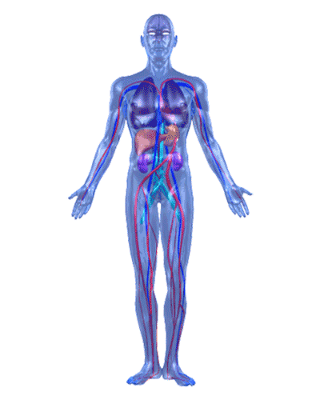
Introduction to the Human Body as a Whole
NURSES PROFESSIONAL EDUCATION
UNIT I

Slide 2
OBJECTIVES:
NURSES PROFESSIONAL EDUCATION
1. Define the term Anatomy & Physiology (A&P)
2. Understand the relationship between A&P
3. Define level of organization of the body
4. Define anatomical position
5. Describe the various body planes.
6. Define the body cavities.
7. Discuss body cavities and list the organs lying within each cavity
8. Identify abdominal pelvic region & quadrant
9. Identify the organs present in Nine (9) abdomino pelvic regions.
10. Briefly discuss the importance of abdomino pelvic quadrants and regions

Slide 3
Define the term Anatomy & Physiology
NURSES PROFESSIONAL EDUCATION
up
Ana-tomy
Process of cutting
Is the study of the structure of the body and the physical relationships between its constituent parts.
Physio-logy
Physio= nature
-logy = study
Is the study of “How "the body systems works

Slide 4
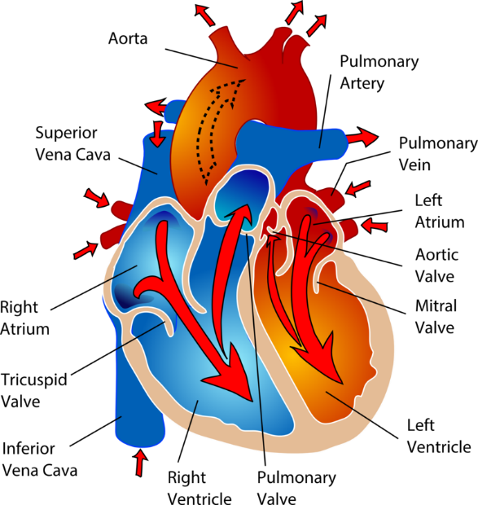
Understand the relationship between A&P
NURSES PROFESSIONAL EDUCATION
Anatomy tells the structure of organ.
Physiology tells the function of the organ or system.

Slide 5
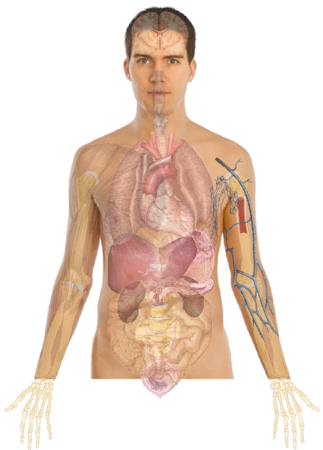
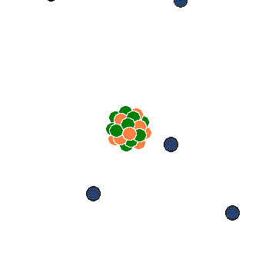
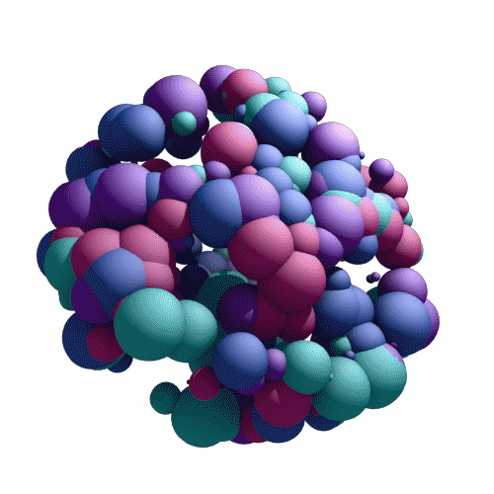
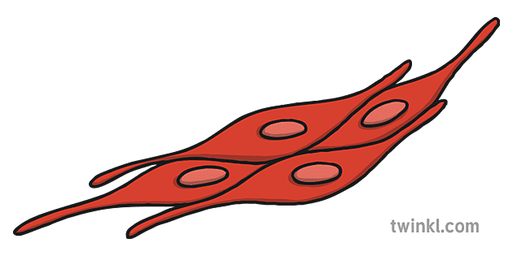
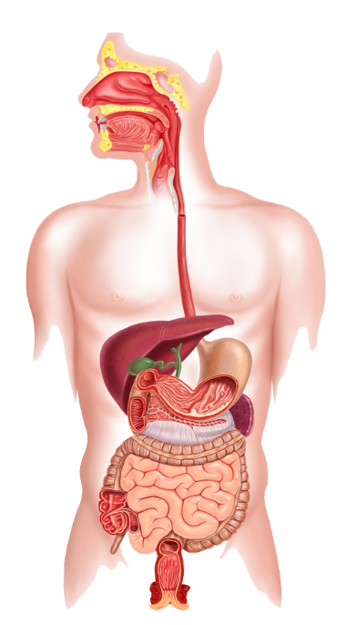
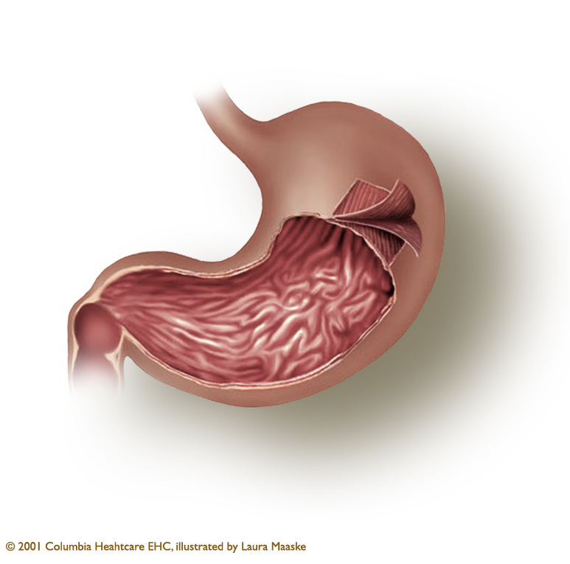
Define level of organization of the body
NURSES PROFESSIONAL EDUCATION
1
CHEMICAL LEVEL
2
Cellular level
Molecules
Atoms (C, H, O, N, P)
3
Tissue level
The human being
5
System level
4
Organ level

Slide 6
Define Anatomical Position
NURSES PROFESSIONAL EDUCATION
Medial (middle)
Superior
Lateral
Lateral
Distal
Anterior view
front
Posterior view
Back
Interior

Slide 7
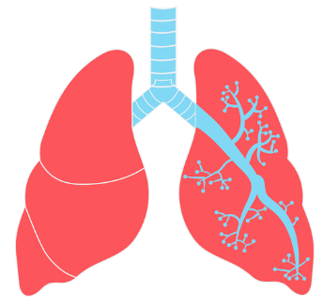
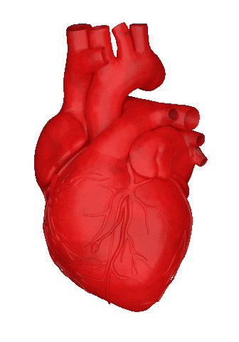
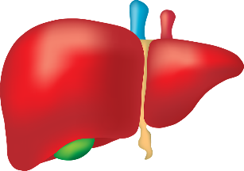
Define Anatomical Position
NURSES PROFESSIONAL EDUCATION
Superior: Toward the head, or the upper part of a structure. The heart is superior to the liver
Inferior: Away from the head, or the lower part of a structure. E.g. The stomach is inferior to the lung
Anterior: Nearer to or at the front of the body. The sternum (breastbone) is anterior to the heart.

Slide 8
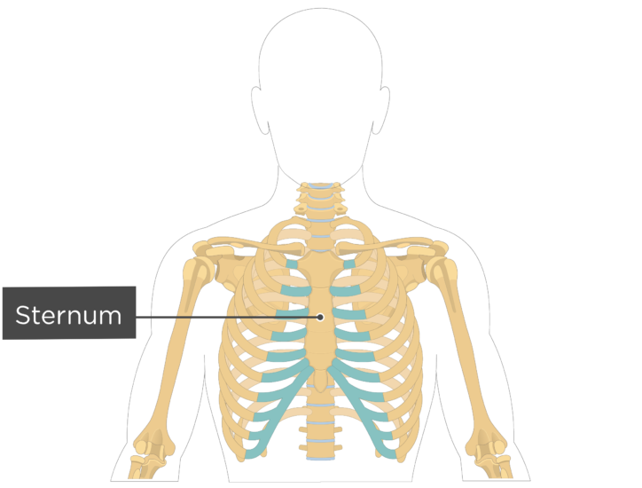
Define Anatomical Position
NURSES PROFESSIONAL EDUCATION
Anterior: Nearer to or at the front of the body. The sternum (breastbone) is anterior to the heart.

Slide 9
Define anatomical position
NURSES PROFESSIONAL EDUCATION
Posterior: Nearer to or at the back of the body. The esophagus is posterior to the trachea (windpipe

Slide 10
Describe the various body planes.
NURSES PROFESSIONAL EDUCATION
Sagittal plane: is a vertical plane that divides the body or an organ into right and left sides.

Slide 11
Describe the various body planes.
NURSES PROFESSIONAL EDUCATION
Transverse plane: divides the body or an organ into superior (upper) and inferior (lower) portions. Other names for a transverse plane are a cross-sectional or horizontal plans

Slide 12
Frontal or Coronal plane: divides the body or an organ into anterior (front) and posterior (back) portions.
Describe the various body planes.
NURSES PROFESSIONAL EDUCATION

Slide 13
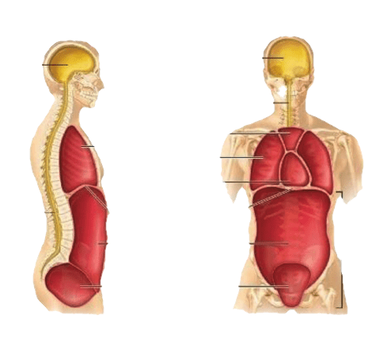
Discuss body cavities and list the organs lying within each cavity
NURSES PROFESSIONAL EDUCATION
Cranial cavity
Thoracic cavity
Pleural cavity
Pericardial cavity
Diaphragm
Abdominopelvic cavity
Pelvic cavity

Slide 14
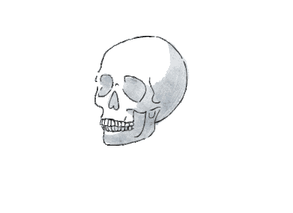
List the Organs lying within Each Cavity
NURSES PROFESSIONAL EDUCATION
Cranial Cavity: Formed by cranial bones and contains brain.

Slide 15
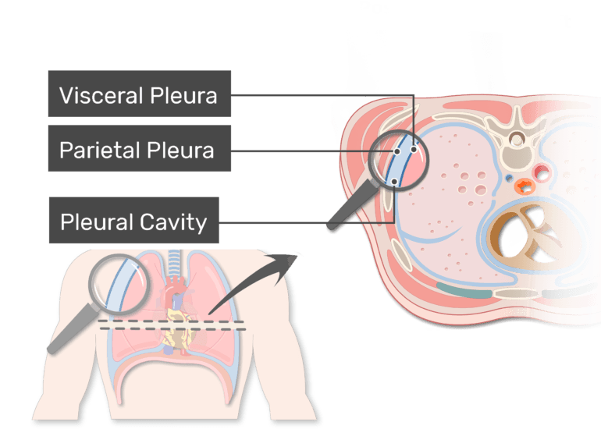
NURSES PROFESSIONAL EDUCATION
Thoracic cavity: Chest cavity; contains pleural and pericardial cavities and mediastinum
Pleural cavity: Each surrounds a lung; the serous membrane of each pleural cavity is the pleura

Slide 16
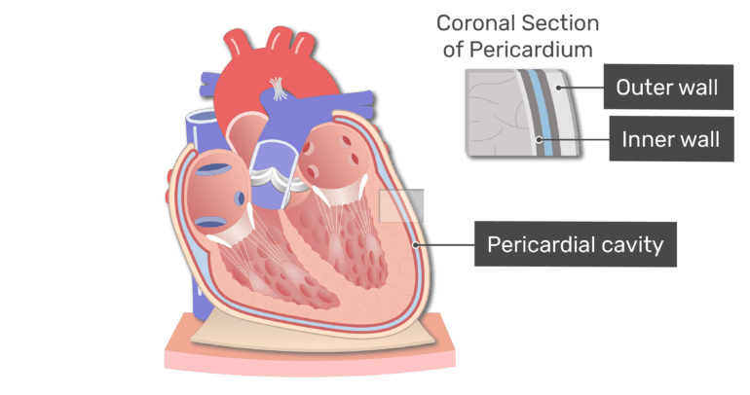
NURSES PROFESSIONAL EDUCATION
Pericardial cavity: Surrounds the heart; the serous membrane of the pericardial cavity is the pericardium

Slide 17
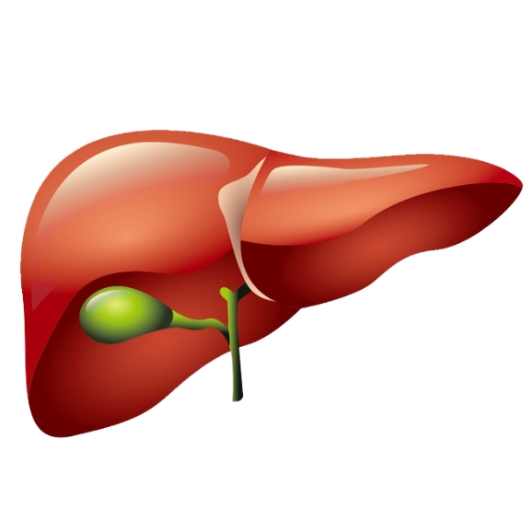
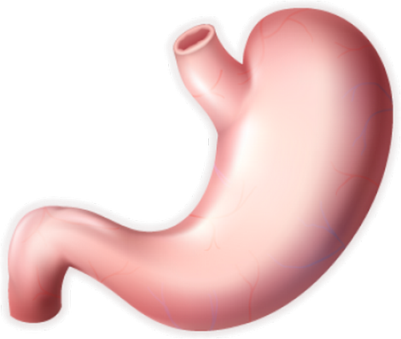
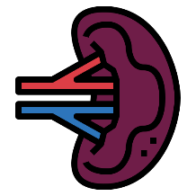
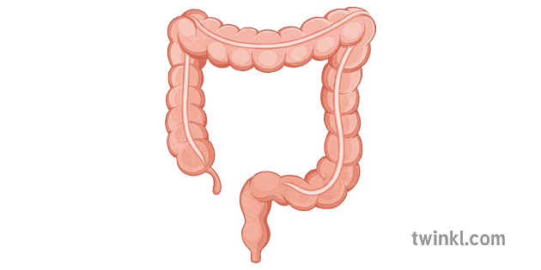
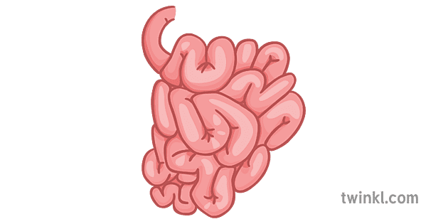
Abdominopelvic cavity: Subdivided into abdominal and pelvic cavities.
NURSES PROFESSIONAL EDUCATION
Abdominal cavity: Contains stomach, spleen, liver, gallbladder, small intestine, and most of large intestine; the serous membrane of the abdominal cavity is the peritoneum

Slide 18
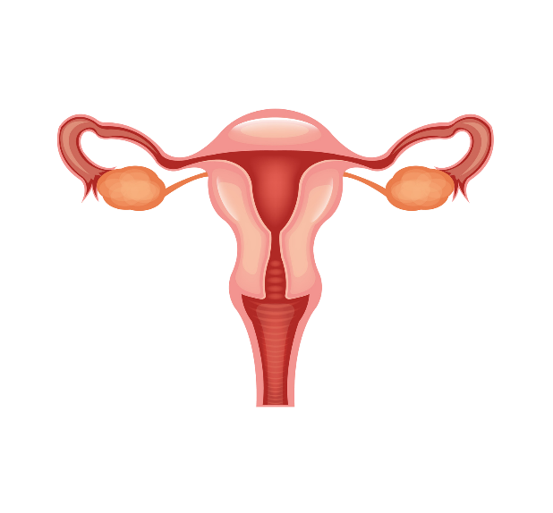
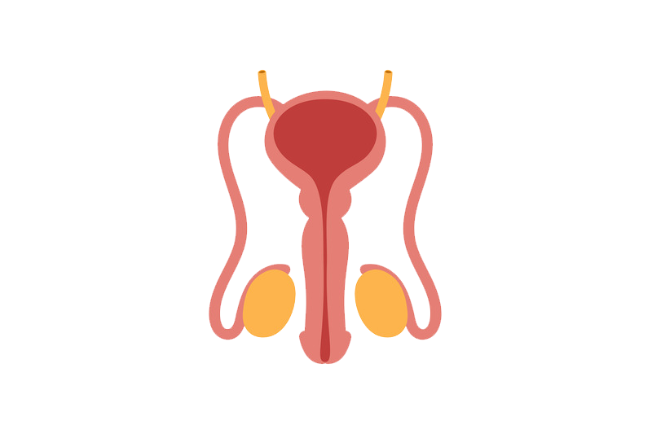
Pelvic cavity: Contains urinary bladder, portions of large intestine, and internal organs of reproduction.
NURSES PROFESSIONAL EDUCATION

Slide 19
NURSES PROFESSIONAL EDUCATION
Identify abdominal pelvic region & quadrant
1
RIGHT UPPER QUADRANT
(RUP)
2
LEFT UPPER QUADRANT
(LUQ)
3
RIGHT LOWER QUADRANT
(RLQ)
4
LEFT LOWER QUADRANT
(LLQ)

Slide 20
NURSES PROFESSIONAL EDUCATION
Identify abdominal pelvic region & quadrant
EPIGASTRIC REGION
RIGHT HYPOCHONDRIAC REGION
LEFT HYPOCHONDRIAC REGION
RIGHT LUMBAR REGION
LEFT LUMBAR REGION
RIGHT INGUINAL (ILIAC) REGION
LEFT INGUINAL (ILIAC) REGION
UMBILICAL REGION
HYPOGASTRIC (PUBIC) REGION

Slide 21
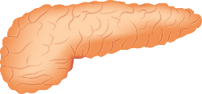
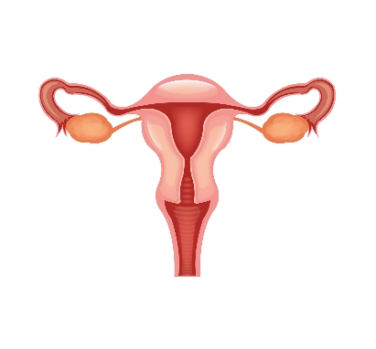
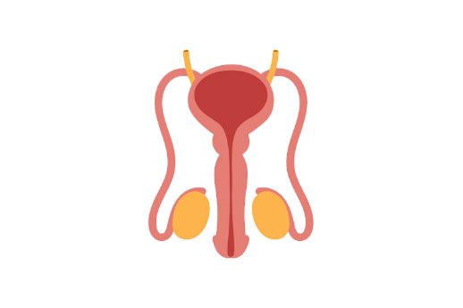
Identify the organs present in Nine (9) Abdomino pelvic regions.
NURSES PROFESSIONAL EDUCATION

Slide 22
Briefly discuss the importance of abdomino pelvic quadrants and regions.
NURSES PROFESSIONAL EDUCATION
The nine-region division is more widely
used for anatomical studies, and quadrants are more commonly
used by clinicians for describing the site of abdominopelvic
pain, tumor, or other abnormality.
RIGHT INGUINAL (ILIAC) REGION

Slide 23
References
NURSES PROFESSIONAL EDUCATION
Guyton, A. C. (2001). Medical Physiology (10th ed) Washington: Kirokawa.
Ross, & Wilson. (2000) Anatomy & Physiology in Health & Illness. Edinburgh: Churchill 8th Edition.
Tortora, G. J. (2000). Principles of Human Anatomy and Physiology (3rd ed). New York: Happer & Row.

Slide 24
THANKS FOR LISTENING ☺
NURSES PROFESSIONAL EDUCATION
For more Presentations like this visit are website : nursesprofessionaledu.com

